Slide 1
F2FIVE HOME
DRILL
ABOUT
TEAM
Bootstrap header
See: slide 3, 4, & 5
US Healthcare Profile
This app will allow you to see chronic illnesses and age-adjusted death rates by state over time
… blah blah compelling
Some navigation language here about how to use the site
This is the TOP of the homepage
Notes:
1. TOP OF HOMEPAGE

Slide 2
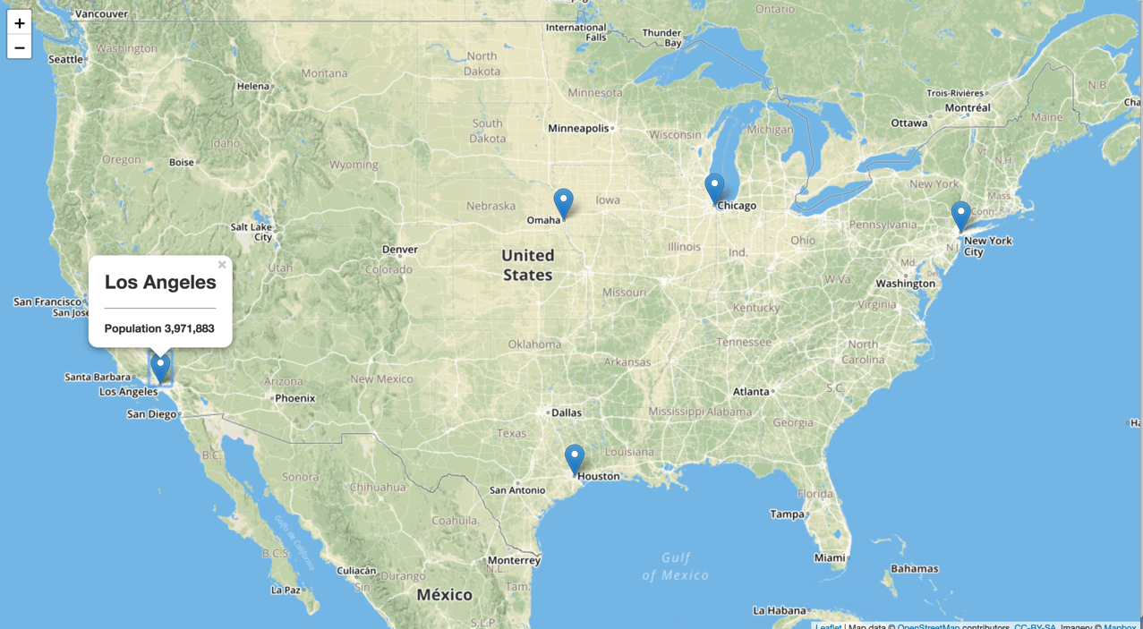

This is the BOTTOM of the homepage
Layer Control:
Clicking diseases to filter
Disease: death rate
Links:
Project source…
Maybe some others
This is the bottom of the homepage
Links:
To the top of the page
© 2018
Notes:
1. SCROLLING DOWN; BOTTOM OF HOMEPAGE

Slide 3
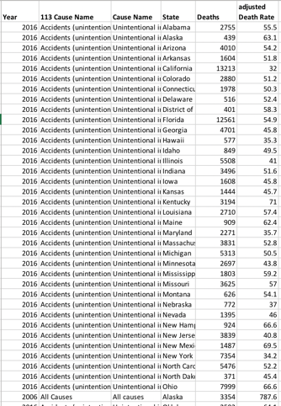
F2FIVE HOME
DRILL
ABOUT
TEAM
Source data: Filters for each category
Pulls from: https://data.cms.gov/resource/ehrv-m9r6.json
Drill Page
Filter
Clear Filter
Summary information will display here
-------------------------------------
A treemap where each cell represents the proportion of deaths by disease controlled by the data filter
Accidents
© 2018
Notes:
2. DRILL-DOWN (the real fun of our project)

Slide 4
F2FIVE HOME
DRILL
ABOUT
TEAM
About page: Proposal language will go here
Inspiration for the project
Potential Hypothesis (if we get that far)
Potential use cases
All data sources and links will go here as well
https://catalog.data.gov/dataset/age-adjusted-death-rates-for-the-top-10-leading-causes-of-death-united-states-2013
© 2018
Notes:
2. ABOUT

Slide 5
F2FIVE HOME
DRILL
ABOUT
TEAM
Team Page
🤨
🧐
😏
🤓
John Commander: * background, * career, * links to portfolio, * linkedin, etc.
John Giglio: … ditto
Bill McGill: … ditto
Jeffrey Box: … ditto
© 2018
Notes:
2. TEAM

Slide 6
Required files
App.py
App.js
Viz 1 – map
Viz 2 – chart
Viz 3 – treemap
Viz 4 - bar
Creating the MongoDB
Index.html (homepage through Git Pages)
Index.html (drill-down)
Index.html (about)
Index.html (team)
css

Slide 7
Workflow
Data source: Wrangle JSON into Mongo
Out to Hosting and Deploying - HTML (last)
Into Flask (RESTful API)
Into Javascript Plotting
- Storing in MongoDB
- Column labels
Flask App.py
Sqlalchemy
Routing
/ = homepage
/year/<filter>
- Build and test outside of call
Integrate into API
New library?
App.js
Viz 1 – map
Viz 2 – chart : x axis = year, bars/y = disease, filtered by state
Viz 3 – treemap (new library)
Viz 4 - bar
HTML design
CSS
Page 1: home
Page 2: drill
Page 3: about
Page 4: team
- What app? Heroku?

Slide 8
Questions to answer
What type of database do we want to use? - John G
Storing the JSON to sqlite and then to Heroku’s free Postgres?
What doe this process look like and is there a better method?
How do we export data to the format we need? Python?
How do we want to display the map filters? Choropleth look/feel? - John C
One layer for each of the diseases
One or many years
For drill-down page: Can we use a flask route with 3 inputs? - Jeff B
What goes in @app.route(“/”)
Can we build @app.route(“/<year>/<state>/<cause-o-death>
What’s the most efficient javascript for managing filters in our drill-down table? - Bill M
Dropdown rather than text search requiring Consistent keywords
How in the hell do we do this on Heroku? - Luke W
Rendering multiple web pages

